Slide 1
DATA CENTER SUPPORT
Cable Assemblies Power Distribution
COMPANY OVERVIEW

Slide 2
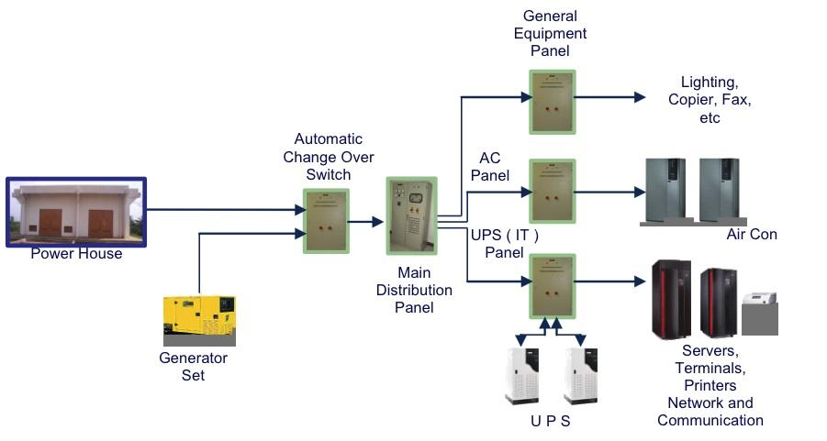
Power Distribution In Data Centers
Overview
Power distribution and equipment are critical aspects of commercial data center infrastructure, ensuring the reliable and efficient operation of the facility.
The primary goal is to efficiently route electrical power from the grid or generator to data center equipment, ensuring stable and uninterrupted operations.
Reliable power distribution is paramount for preventing downtime, ensuring data integrity, and maintaining overall data center performance.

Slide 3
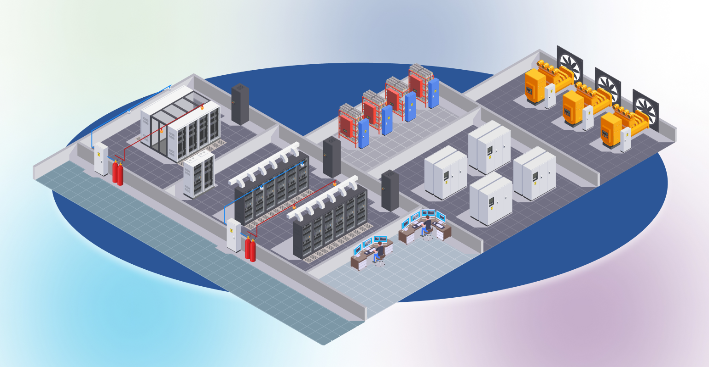
Power Distribution In Data Centers
Power Sources
Utility Power: Most data centers are connected to the electrical grid for a primary power source. This power is distributed through the local utility's electrical infrastructure.
Backup Power: To ensure uninterrupted operations, data centers often have backup power systems, such as generators and uninterruptible power supply (UPS) units. These systems provide temporary power during outages until primary power is restored or until a graceful shutdown can be executed.

Slide 4
Power Distribution In Data Centers
Power Distribution Units (PDUs)
PDUs are devices that distribute electrical power to multiple pieces of equipment from a single source.
They come in various types, including basic, metered, monitored, and switched PDUs.
The choice depends on the level of control and monitoring required for each specific application.

Slide 5
Power Distribution In Data Centers
Redundancy and Reliability
Data centers implement redundant power systems to ensure continuous operations even in the event of equipment failure or maintenance. This includes dual power feeds to IT equipment, dual power supplies in servers, and redundant UPS and generator systems.
This duplication is designed to provide backup resources and prevent a single point of failure, enhancing the overall reliability and availability of the data center infrastructure.

Slide 6
Power Distribution In Data Centers
Busway Systems
Busway systems provide a flexible and scalable means of distributing power within a data center.
They consist of a busbar, typically housed within an aluminum enclosure. The busbar carries the electrical current and taps off to units that connect to IT equipment.
Busways allow for easy reconfiguration and expansion of power distribution.

Slide 7
Power Distribution In Data Centers
Rack Power Distribution
Power is often distributed at the rack level using rack-mounted PDUs.
These devices can support a mix of power outlets and may include features such as metering, remote monitoring, and power management capabilities.
Rack PDUs offer another method of efficient and organized delivery of power to the individual IT equipment housed in server racks.

Slide 8
Power Distribution In Data Centers
Power Monitoring and Management
Monitoring the power usage effectiveness (PUE) of a data center is crucial for efficiency.
Advanced power management systems provide real-time monitoring, reporting, and control over power consumption, enabling optimization and cost reduction.
By implementing power monitoring practices, data center operators can contribute to sustainability goals by minimizing energy waste.

Slide 9
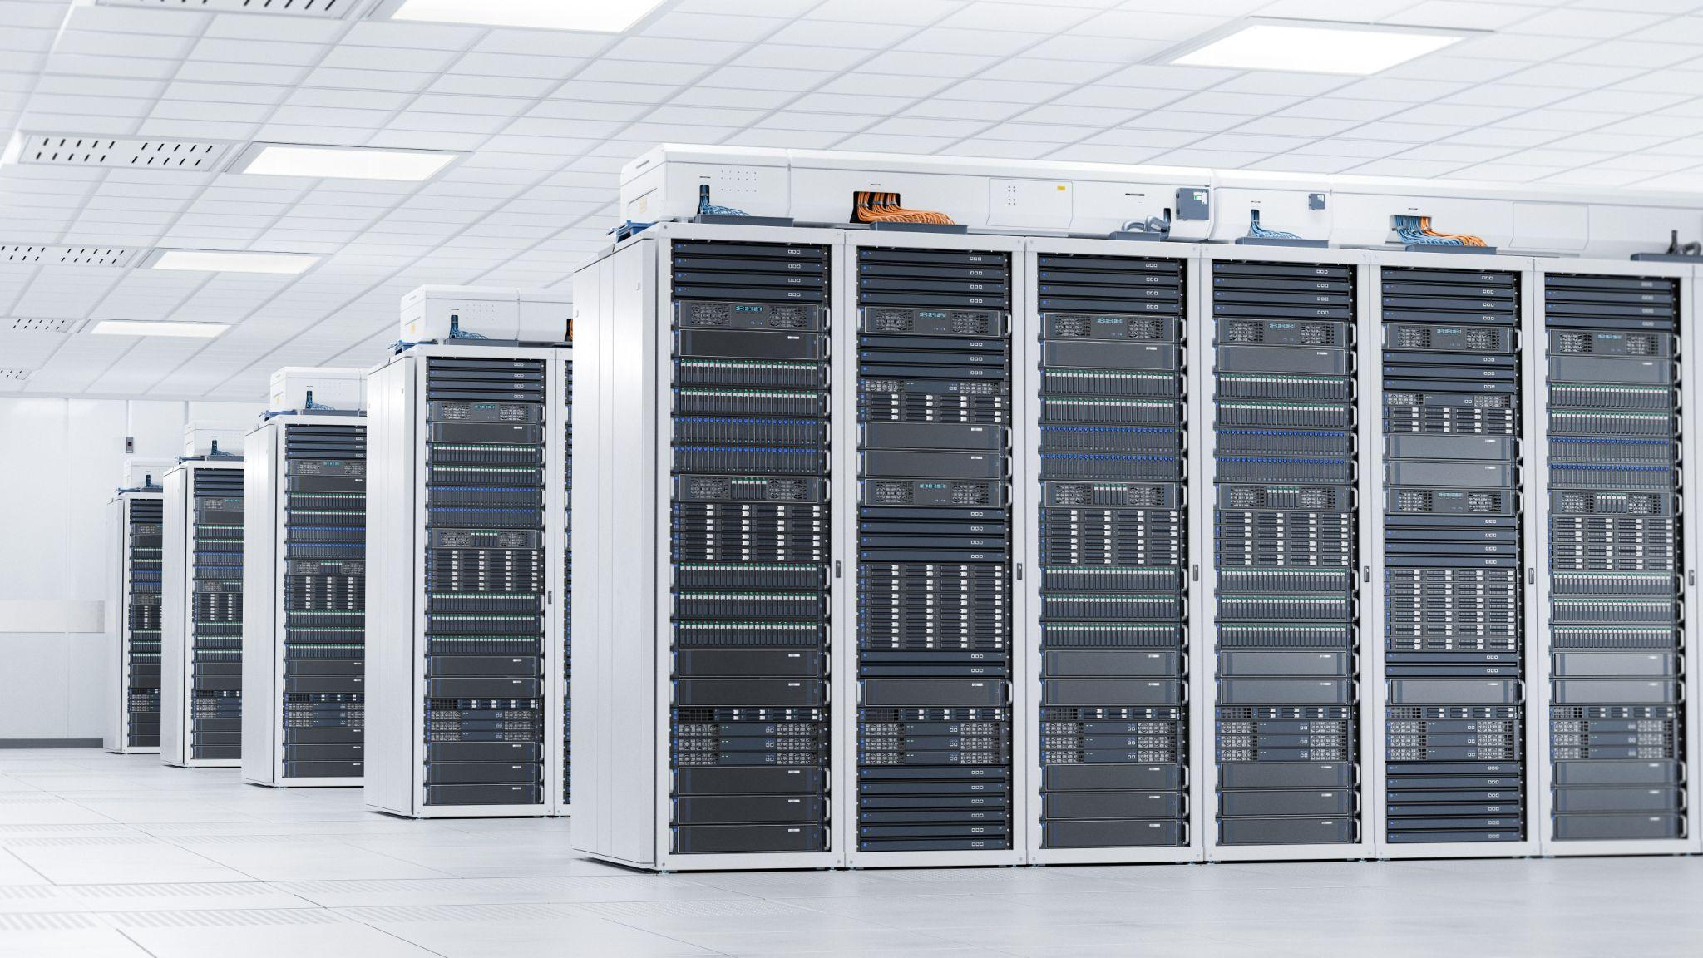
Power Distribution In Data Centers
Cooling Systems
Power distribution is closely tied to cooling system in data centers. Efficient cooling mechanisms are essential to prevent equipment from overheating and ensure reliable operations.
Data centers often employ precision air conditioning, liquid cooling mechanisms, or a combination of these systems to maintain optimal operating conditions.

Slide 10
Power Distribution In Data Centers
Energy Efficiency
Green initiatives and cost considerations drive data centers to focus on energy efficiency. This includes selecting energy efficient power distribution equipment, optimizing airflow for efficient cooling, and adopting new technologies such as variable frequency drives to match cooling and power requirements with actual demand.

Slide 11
Power Distribution In Data Centers
Cabling and Wire Management
Proper cable management is crucial to avoid the risk of power distribution issues. Well-organized cabling minimizes the risk of accidental disconnections, reduces electromagnetic interference, and makes maintenance and upgrades more manageable.
Effective cable management systems help contribute to overall reliability and performance of the data center’s power infrastructure.

Slide 12
Power Distribution In Data Centers
Compliance and Safety
Data centers must adhere to safety standards and regulations for electrical systems. Compliance with codes such as NFPA 70 (National Electrical Code) ensures that power distribution systems are installed and maintained safely.
Regular assessments and updates to policies and procedures are critical to stay up to date with evolving regulations and industry best practices.

Slide 13
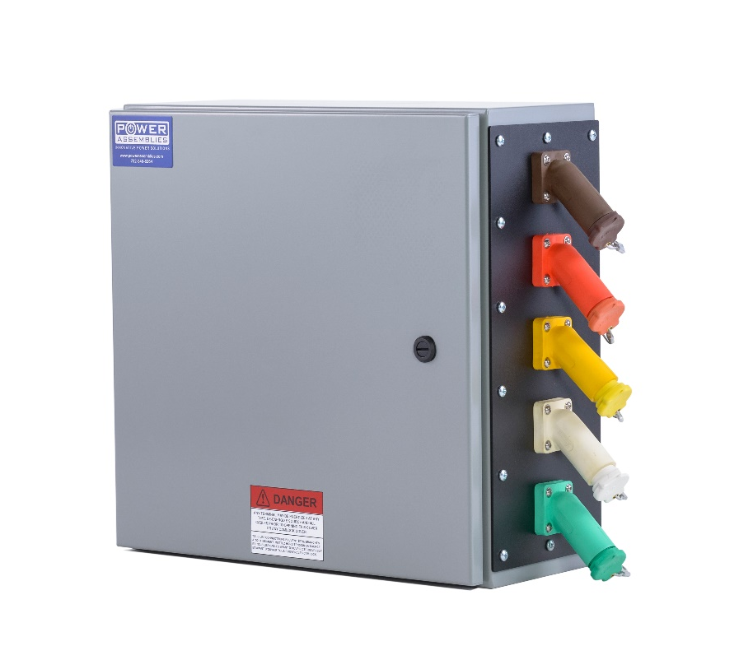
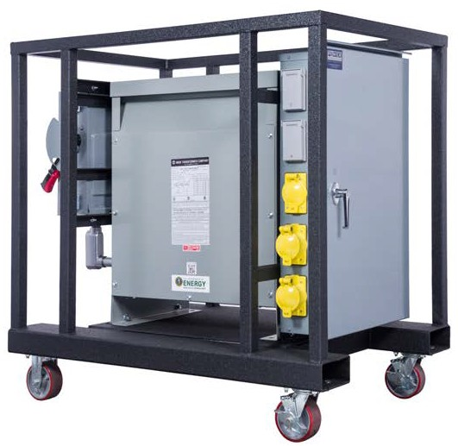
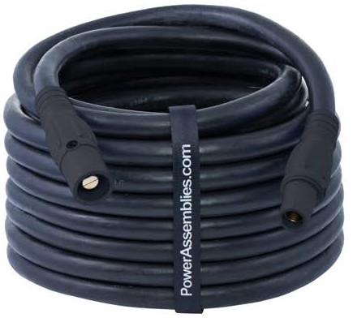
Power Assemblies Products
for Data Centers
CABLE ASSEMBLIES
POWER DISTRIBUTION
We help our distributors round out their product line and add value to their customers with products that are built simply, meet all latest electrical codes, and are made of the highest quality materials.
Our team of engineers can design the perfect power solution for your situation.
ENGINEERED POWER
SOLUTIONS
Designed with the customer in mind

Slide 14
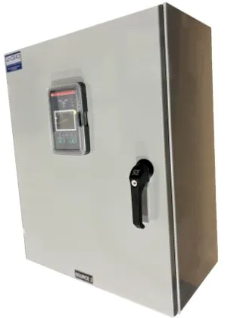
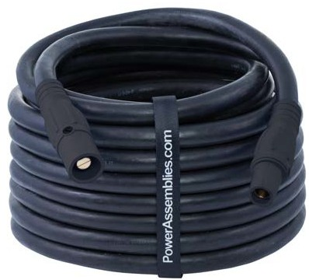
INNOVATIVE
POWER
SOLUTIONS
CAMLOCK CONNECTION BOX
DUAL VOLTAGE TRANSFER SWITCHES
GENERATOR CONNECTION BOXES
Scalable power solutions for uninterrupted operations.
GENERATOR DOCKING STATIONS
LOAD BANK STATIONS
CABLE ASSEMBLIES

Slide 15
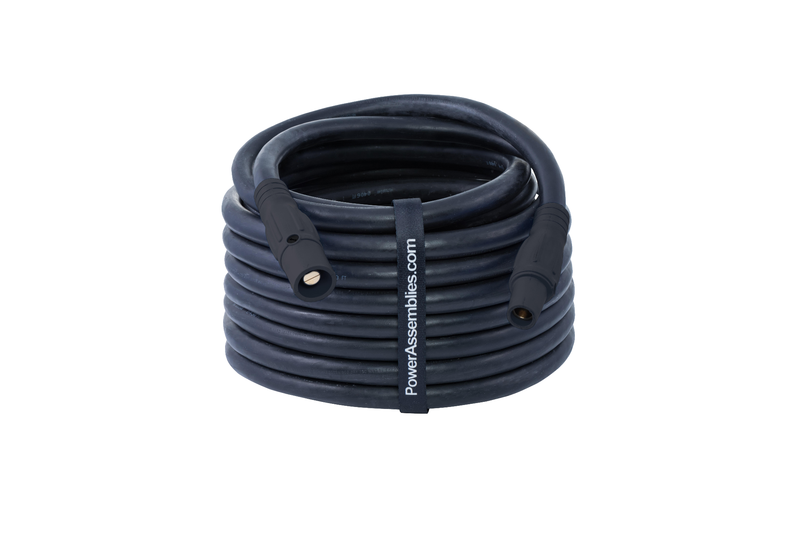
CABLE ASSEMBLIES
POWER DISTRIBUTION
Our Cable Assemblies consist of high-quality cable and Series 16 Camlocks that are designed to be used in conjunction with portable generators to provide portable, off-grid power when you need it most. We offer a broad selection of premium power cables to match nearly any temporary power application.
EFFICIENT. DURABLE.FLEXIBLE.
Series 16 Camlocks
Type W Jacket
UL/CSA Listed and RoHS Approved Components

Slide 16
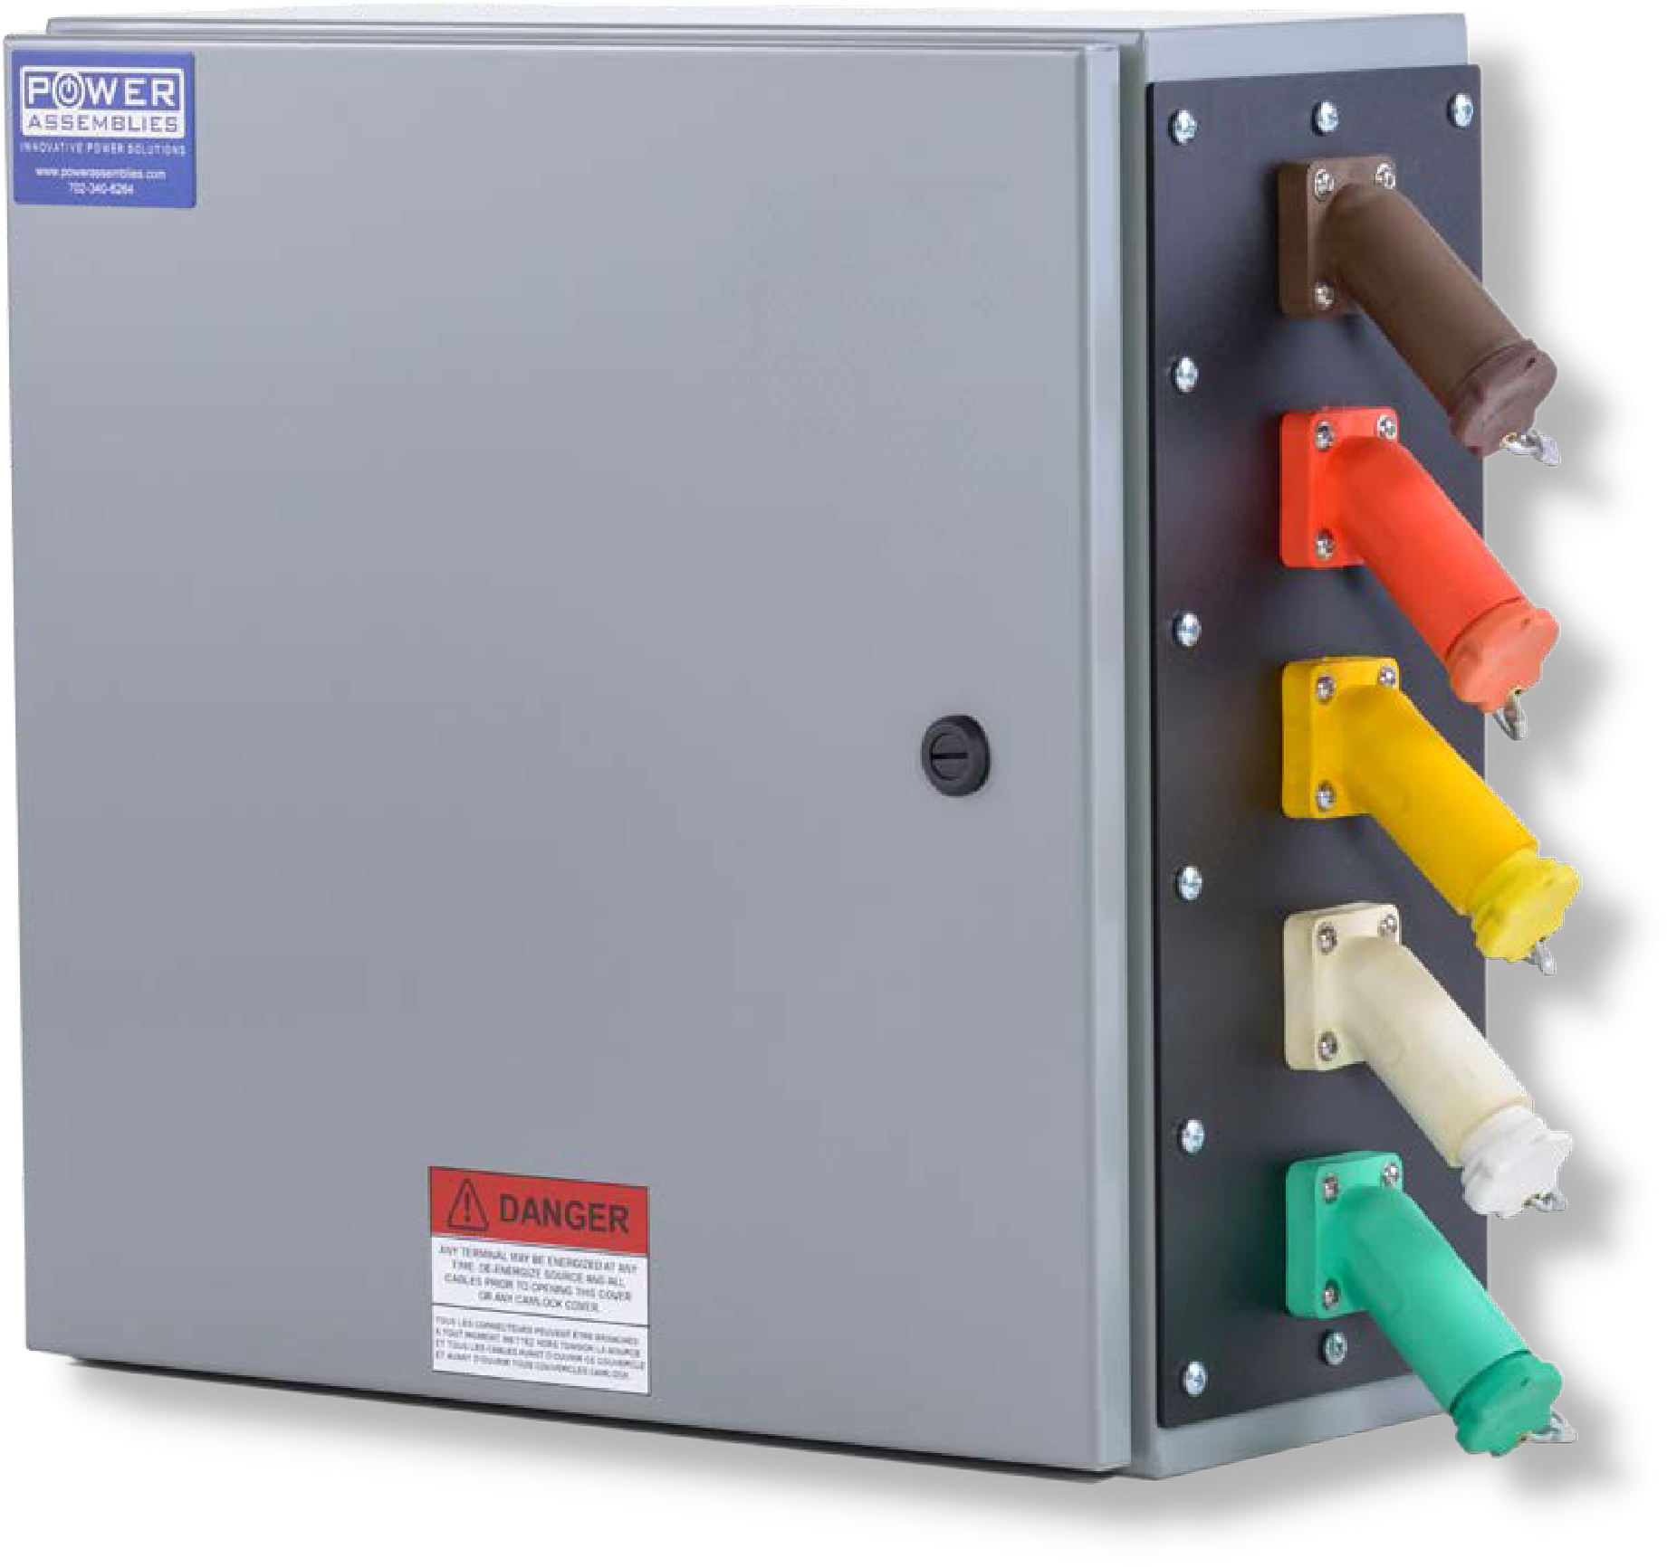
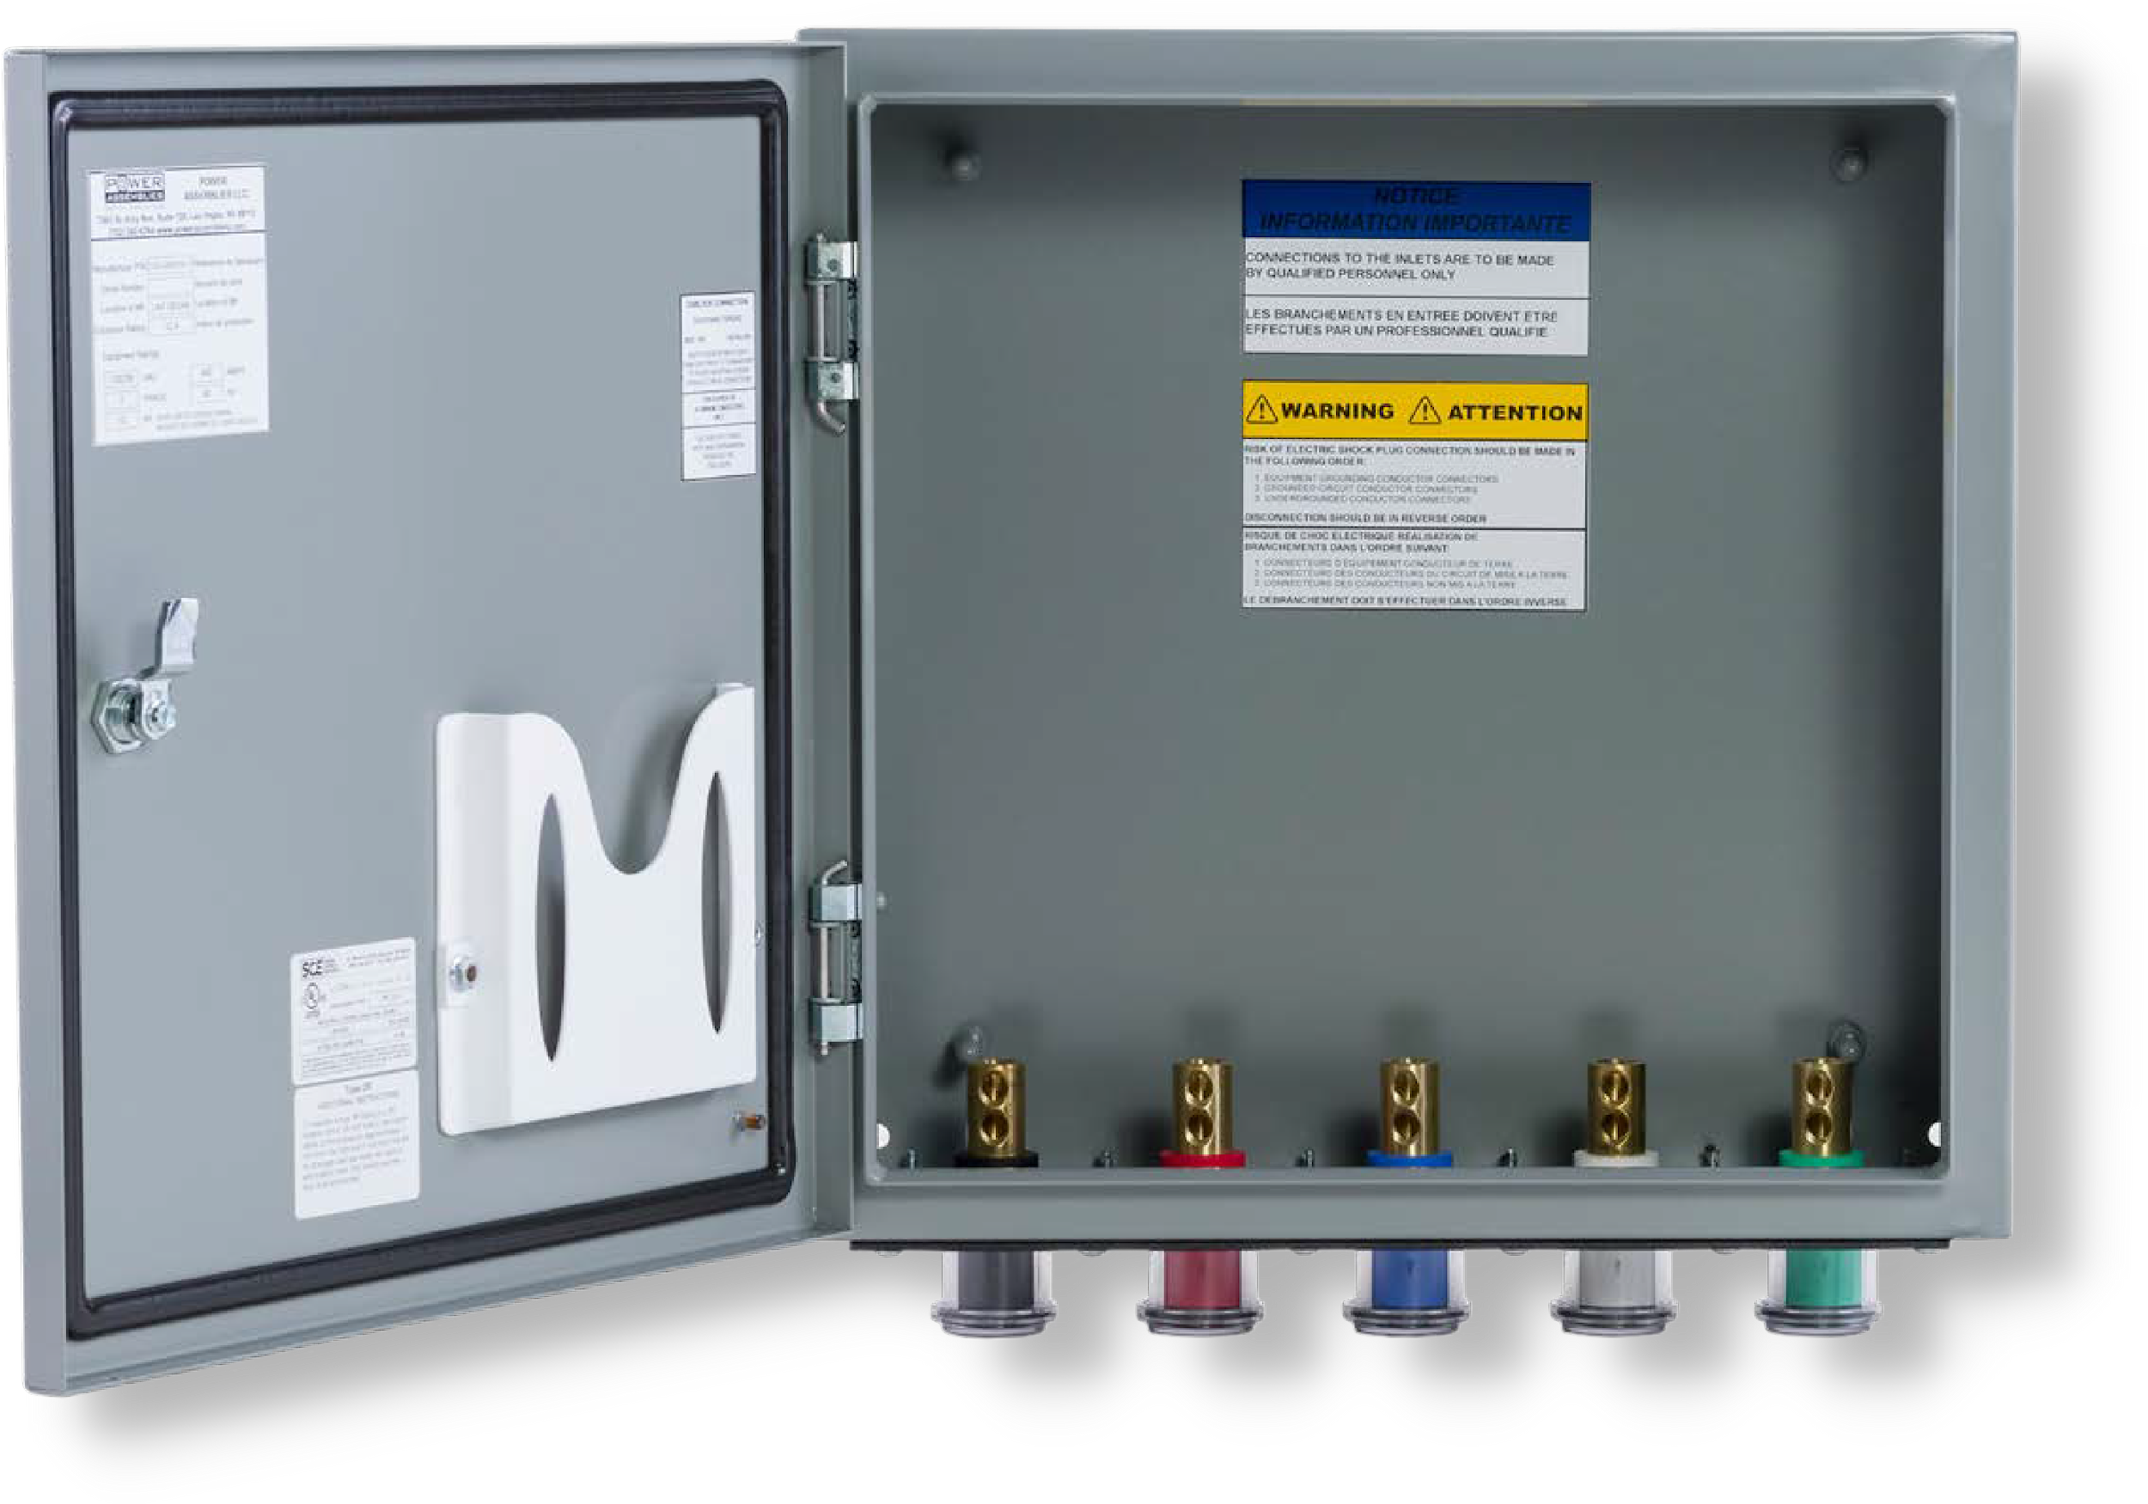
CAMLOCK CONNECTION BOX
POWER DISTRIBUTION
The Power Assemblies Cam Lock Connection Box provides provides quick and easy connections with the use of industry-standard Series 16 Camlocks. This affordable power solution is available in a wide range of configurations to meet the needs of various applications.
QUICK. SIMPLE.
VERSATILE.
Series 16 Camlocks
Durable Powder-Coating
Protective Camlock Covers
400A & 800A Configurations
Portable Generator Compatibility
NEMA 3R Outdoor Rated Enclosure

Slide 17
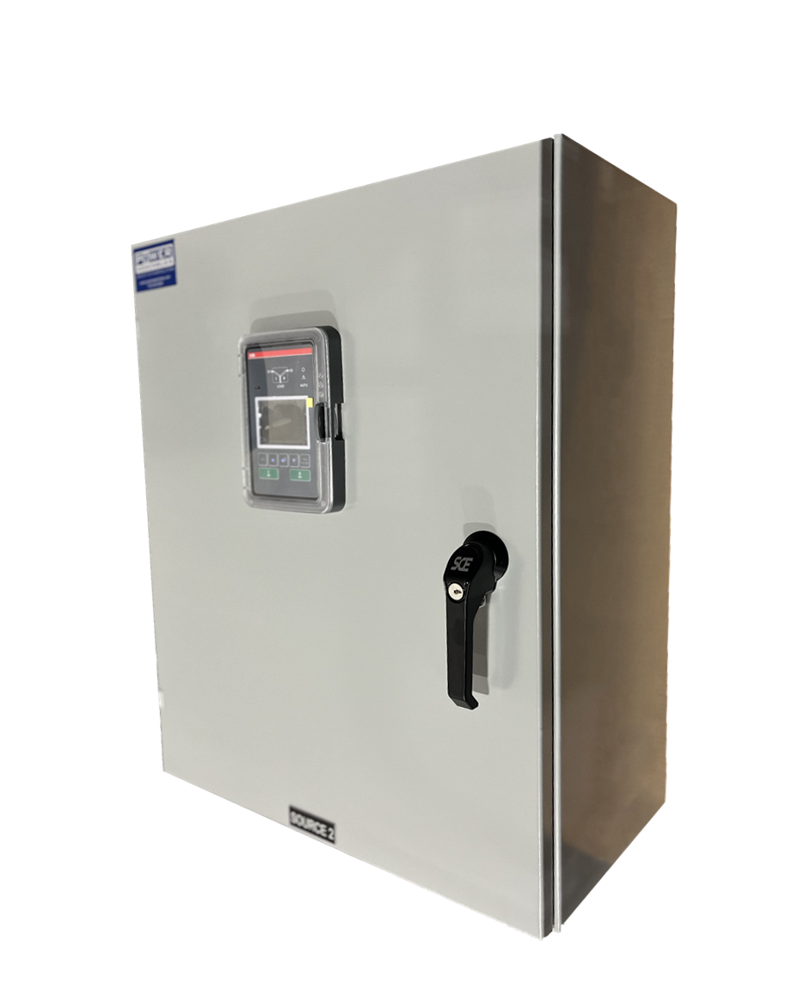
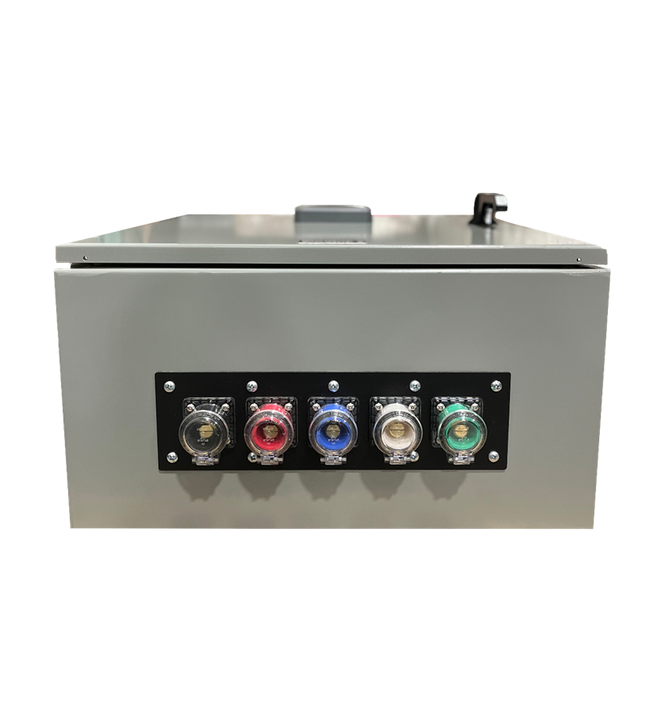
DUAL VOLTAGE
TRANSFER SWITCH
POWER DISTRIBUTION
The Power Assemblies Automatic Transfer Switch is a Dual Voltage Variant Switch, meaning that it has auto-sensing technology to operate under a range of voltages from 200V to 480V. This transfer switch guarantees the continuous delivery of electricity during a power outage. It delivers power from one of two power sources to a connected load circuit and is available with or without Series 16 Camlock Inputs.
QUICK.
EFFICIENT.
SAFE.
100A - 200A Options
Dual Voltage Operation
Series 16 Camlock Input/Output
Carbon or Stainless Steel
Detachable Human Interface Controls
Custom Configurations Available

Slide 18
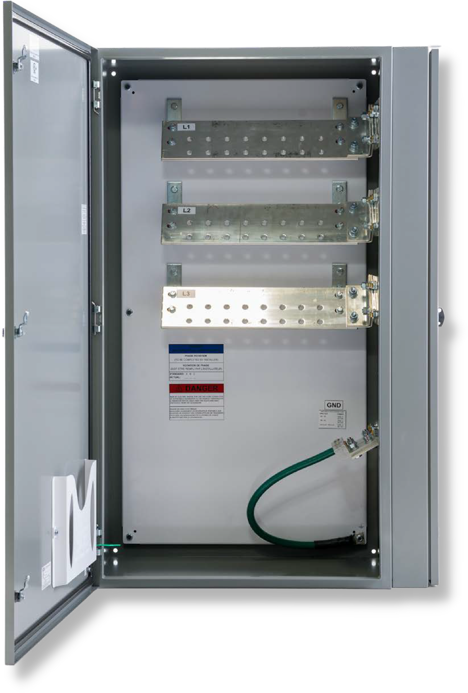
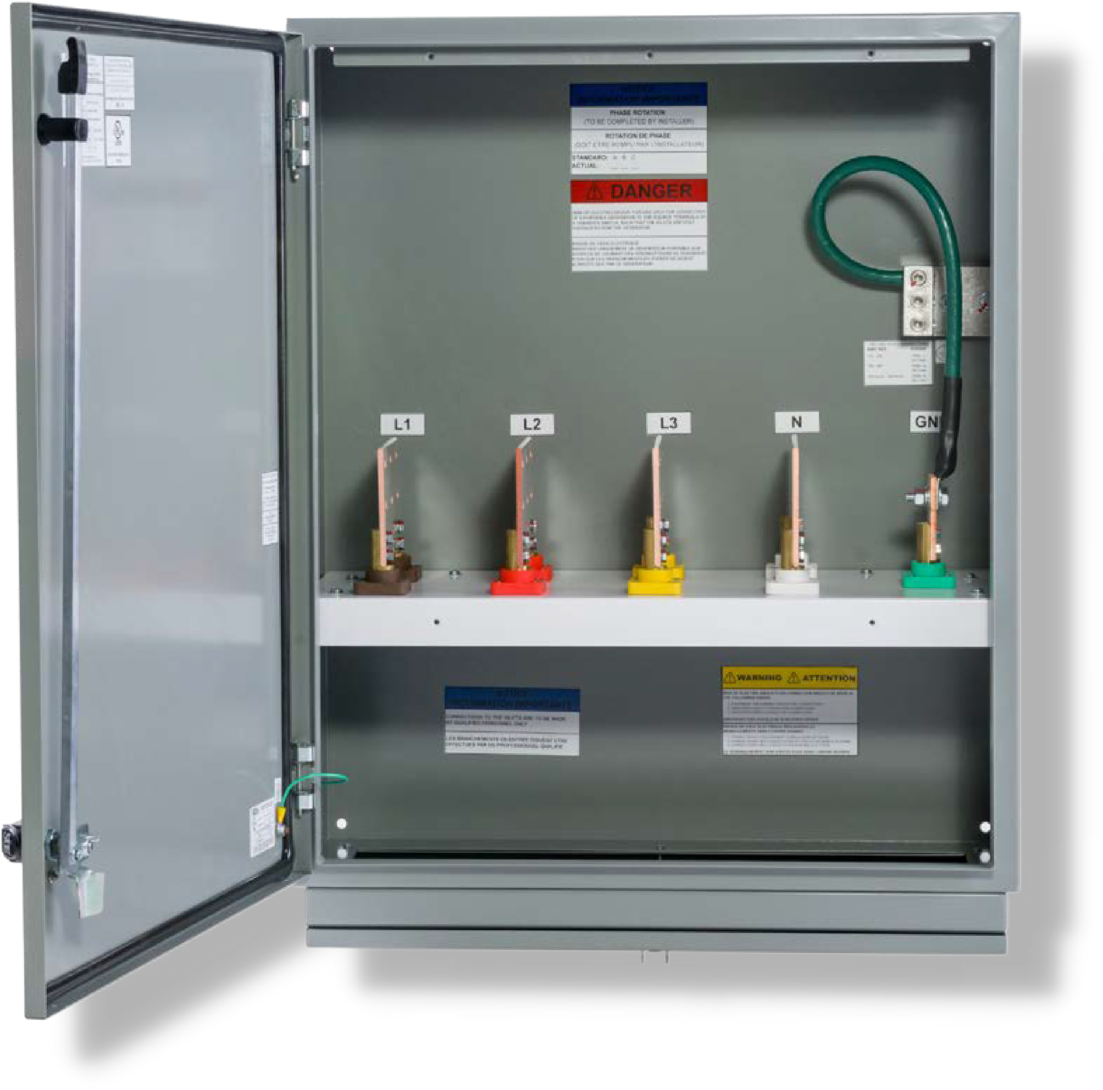
GENERATOR DOCKING STATION
POWER DISTRIBUTION
The Power Assemblies Generator Docking Station is a high-quality, low-cost unit with a camlock quick connection system. The Generator Docking Station is used in conjunction with a transfer switch to provide a convenient, quick connect option for emergency power. The mini, compact, and standard system configurations allow for numerous wiring possibilities to fit customer and building requirements.
EFFECTIVE. SIMPLE.
CONVENIENT.
Lockable
400A-2000A Options
CULus Listed
UL 1008
NEMA 4/12 Carbon Steel Enclosure Pad-Mounted Standard GDS Option
Wall-Mounted Compact & Mini GDS Options

Slide 19
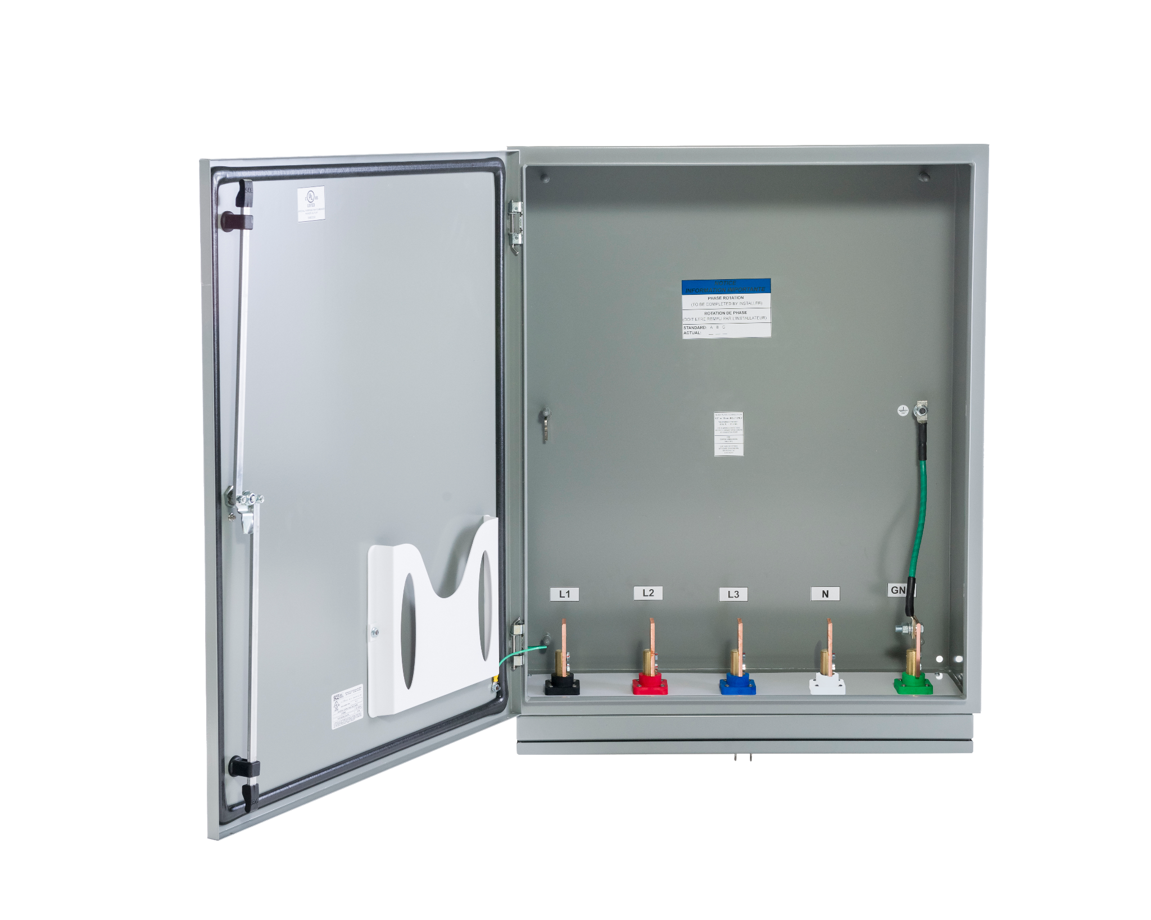
LOAD BANK STATION
POWER DISTRIBUTION
The Power Assemblies Load Bank Stations make for easy routine maintenance and testing. Load banking is the process of testing a generator with an “artificial load” to see if the generator can operate properly at its rated amperage. Our Load Bank Stations come with Series 16 female camlock connectors that allow quick access to your generator for testing without any hard wiring.
RELIABLE. SIMPLE.
EFFICIENT.
Lockable
400A-2000A Options CULus Listed UL 1008
NEMA 4/12 Carbon Steel Enclosure Pad-Mounted Standard GDS Option
Wall-Mounted Compact & Mini GDS Options

